Slide 1


SOFTWARE ENGINEERING (Week-12)
Usama Musharaf
Lecturer (Department of Computer Science)
FAST-NUCES Peshawar

Slide 2
Content of Week # 12
JUnit Testing
@annotations
@Test
@BeforeEach
@AfterEach
@BeforeAll
@AfterAll
etc….
Conditional @annotations
Operating System based conditional annotations
JRE based conditional annotations
Custom condition based conditional annotations
@Assertions
@assertEquals
@assertNotEquals
@assertArrayEquals
@assertTrue
@assertFalse
Working with multiple assertions

Slide 3
What are annotations?
Annotations are metadata about your source code.
Identified with @symbol.
Annotations are used with methods, classes, interfaces, variables, etc.

Slide 4
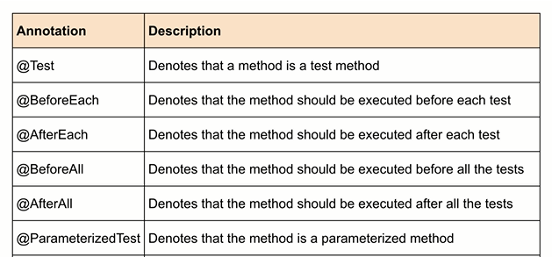
Annotations

Slide 5
Writing first Unit Test

Slide 6
Demo

Slide 7
Conditional annotations
Conditional annotations allows developers to enable or disable certain tests based on certain conditions.

Slide 8
Conditional annotations
Operating System based conditional annotations
JRE based conditional annotations
Custom condition based conditional annotations

Slide 9
Operating System based conditional annotations
@EnabledOnOs (OS.WINDOWS)
@DisabledOnOs (OS.MAC)
@EnabledOnOs (OS.WINDOWS, OS.MAC)

Slide 10
JRE based conditional annotations
@EnabledOnJre (JRE.JAVA_16)
@DisabledOnJre (JRE.JAVA_16)
@DisabledOnJre (JRE.JAVA_14, JRE.JAVA_16)
@EnabledForJreRange (min=JRE.JAVA_9, max=JRE.JAVA_13)
@DisabledForJreRange ()

Slide 11
Custom conditions based conditional annotations
Using custom conditions, a test can be enabled or disabled based on a boolean value that a method returns.
@EnabledIf
@DisabledIf

Slide 12
Display Names
Display Names are used to give custom name to your test cases that will be displayed in the test report.
@DisplayName(“name”)

Slide 13
Controlling the execution order of Tests
DisplayName → sorts the test methods alphanumerically based on the display name of the method.
MethodName → sorts the test methods alphanumerically based on the name of the method and parameters list.
OrderAnnotation → sorts the method alphanumerically based on the @Order annotation specified with the test method.
Random → executes tests in Random order

Slide 14
Controlling the execution order of Tests
@TestMethodOrder(MethodOrderer.OrderAnnotation.class)
class ControllingExecutionOrder
{
@Test
@Order(1)
public void firstTest(){
System.out.println("First test executed");
}
@Test
@Order(2)
public void secondTest(){
System.out.println("Second test executed");
}
@Test
@Order(3)
public void thirdTest(){
System.out.println(“Third test executed");
}
}

Slide 15
Demo

Slide 16
Assertions

Slide 17
What are Assertions?
Assertions help software programmers to verify the output of a particular function or part of software.
We write assertions to test our assumptions around a particular piece of code.
When the assertion is executed it is assumed to be true, if the assumption is not correct then the test fails.

Slide 18
AssertEquals
@Test
public void assertDemo()
{
JavaOperations javaOperations = new JavaOperations();
int actual = javaOperations.add(4, 4);
Assertions.assertEquals(8, actual);
Assertions.assertEquals(8, actual, "Assertion add(4,4) failed");
}

Slide 19
AssertNotEquals
@Test
public void assertNotEqualsDemo()
{
JavaOperations javaOperations = new JavaOperations();
//Assertions.assertNotEquals(9, javaOperations.add(4,5));
Assertions.assertNotEquals(9, javaOperations.add(4,5), "Assertion add(4,5) failed");
}

Slide 20
Assertion With Arrays
@Test
public void assertsWithArraysDemo()
{
int a[] = {2, 2, 3};
int b[] = {1, 2, 3};
//Assertions.assertEquals(a, b);
//Assertions.assertArrayEquals(a, b);
Assertions.assertArrayEquals(a, b, "Comparison of arrays failed");
}

Slide 21
Assertion True
@Test
public void assertForTrue()
{
String test = “I am a programmer";
//Assertions.assertTrue(test.startsWith(“I"));
Assertions.assertTrue(test.startsWith("J"), "Test assertTrue failed");
}

Slide 22
Assertion False
@Test
public void assertForFalse()
{
String test = "I am a programmer";
//Assertions.assertFalse(test.startsWith("J"));
Assertions.assertFalse(test.startsWith("I"), "Test assertFalse failed");
}

Slide 23
Working with Multiple Assertions
public class GroupedAssertions
{
@Test
public void multipleAssertions()
{
JavaOperations javaOperations = new JavaOperations();
Assertions.assertEquals(5, javaOperations.add(3, 1));
Assertions.assertEquals(25, javaOperations.add(3, 22));
Assertions.assertEquals(100, javaOperations.add(70, 30));
}

Slide 24
Working with Multiple Assertions
@Test public void groupAssertionDemo()
{
JavaOperations javaOperations = new JavaOperations();
Assertions.assertAll (
() -> Assertions.assertEquals(5, javaOperations.add(3, 1)),
() -> Assertions.assertEquals(26, javaOperations.add(3, 22)),
() -> Assertions.assertEquals(101, javaOperations.add(70, 30)) );
}

Slide 25
HAVE A GOOD DAY!

